Slide 1
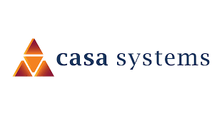
Alepo- Overview of Kubernetes
Presented to CASA systems | DD - MMM - YYYY

Slide 2
AGENDA

Slide 3
Agenda
Overview of Kubernetes
Components of Kubernetes
Architecture Diagram
Kubernetes Key Commands

Slide 4
Overview of Kubernetes
  Kubernetes is a portable, extensible, open-source platform for managing containerized workloads and services, that facilitates both declarative configuration and automation.
  Kubernetes also known as K8s.
  Kubernetes is open source giving you the freedom to take advantage of on-premises, hybrid, or public cloud infrastructure, letting you effortlessly move workloads to where it matters to you.
  Kubernetes can scale without increasing your ops team.
  It has a large, rapidly growing ecosystem.
  Kubernetes services, support, and tools are widely available.

Slide 5
Components of Kubernetes
  A Kubernetes cluster consists of a set of worker machines, called nodes, that run containerized applications.
  Every cluster has at least one worker node.
  The worker node(s) host the Pods that are the components of the application workload.
  The control plane manages the worker nodes and the Pods in the cluster.
  In production environments, the control plane usually runs across multiple computers and a cluster usually runs multiple nodes, providing fault-tolerance and high availability.

Slide 6
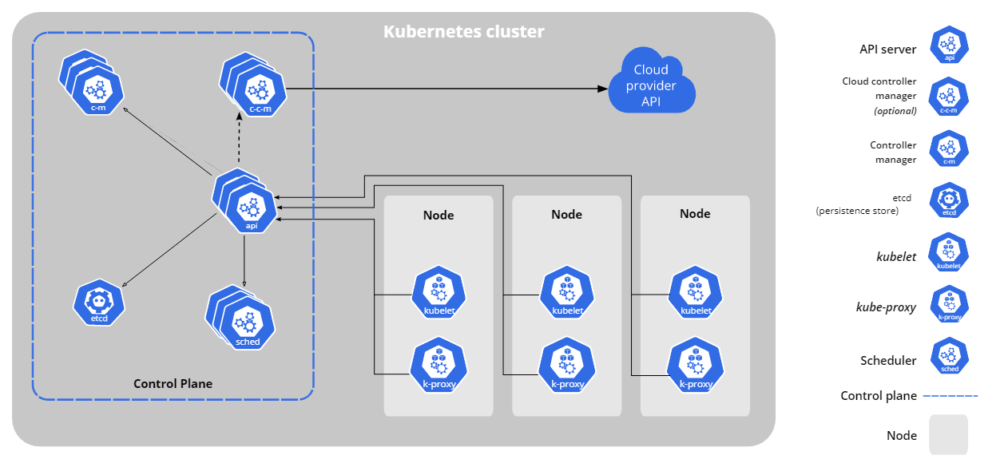
Diagram of a Kubernetes cluster with all the components
Notes:
Control Plane Components: The control plane's components make global decisions about the cluster (for example, scheduling), as well as detecting and responding to cluster events
kube-apiserver
The API server is a component of the Kubernetes control plane that exposes the Kubernetes API. The API server is the front end for the Kubernetes control plane.
etcd
Consistent and highly-available key value store used as Kubernetes' backing store for all cluster data.
kube-scheduler
Control plane component that watches for newly created Pods with no assigned node and selects a node for them to run on.
kube-controller-manager
Control plane component that runs controller processes.
cloud-controller-manager
A Kubernetes control plane component that embeds cloud-specific control logic. The cloud controller manager lets you link your cluster into your cloud provider's API, and separates out the components that interact with that cloud platform from components that only interact with your cluster.
Node Components
Node components run on every node, maintaining running pods and providing the Kubernetes runtime environment.
Container runtime
The container runtime is the software that is responsible for running containers.
Addons
Addons use Kubernetes resources (DaemonSet, Deployment, etc) to implement cluster features.
DNS
While the other addons are not strictly required, all Kubernetes clusters should have cluster DNS, as many examples rely on it.
Web UI (Dashboard)
Dashboard is a general purpose, web-based UI for Kubernetes clusters.
Container Resource Monitoring
Container Resource Monitoring records generic time-series metrics about containers in a central database, and provides a UI for browsing that data.
Cluster-level Logging
A cluster-level logging mechanism is responsible for saving container logs to a central log store with search/browsing interface

Slide 7
Kubernetes Key Commands
kubectl get pods -n <namespace-name>
kubectl describe pods <pod-name> -n <namespace-name>
kubectl get namespace
kubectl get pods -n <namespace-name>-o wide
kubectl get pods -A -o wide
kubectl exec -it <pod_name> -c couchbase -n alepo -- sh
kubectl get svc -n <namespace-name>
kubectl cordon <server_name>
kubectl uncordon <server_name>
kubectl get cm -n alepo
kubectl get cm -n alepo pcf-pcrf--pcf -o yaml

Slide 8
Show & Tell Session
  Kuberenetes

Slide 9
Corporate HQ
Austin, TX, USA
sales@alepo.com
Follow Us
www.alepo.com
AlepoUSA
@AlepoUSA
Company/Alepo

